Slide 1
Digital Inequities in Western New York, 2020
Heidi Ziemer, Western New York Library Resources Council

Slide 2
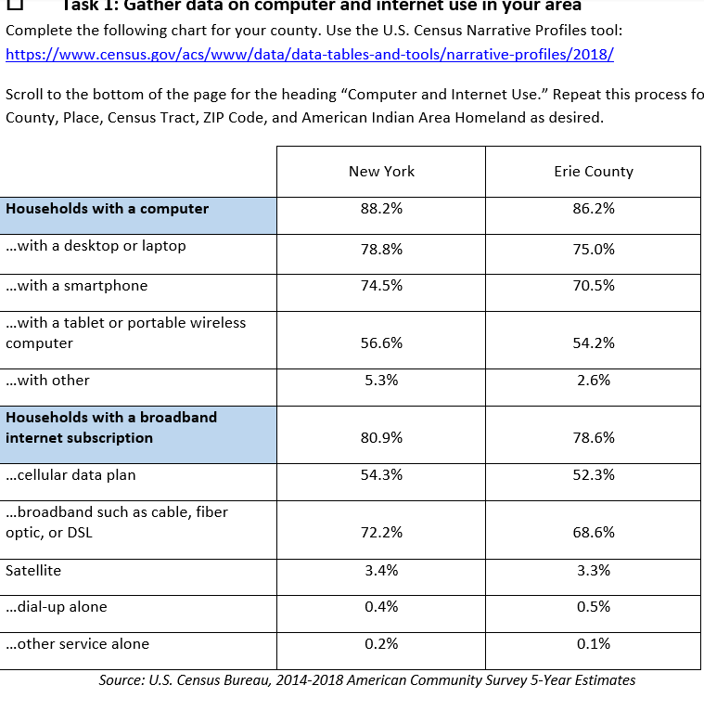
The Digital Divide Worksheet
Households in Erie County are just slightly below the state average in most cases of both broadband and device access
Overall, New York broadband and device access numbers mean that about 20-25% of the population still lack any broadband and/or devices.
Moreover, what is available may not be adequate to the needs of the individuals in households.
Where are the biggest gaps?
Notes:
Data can be deceiving - the numbers that are so often mentioned in the media can create a kind of complacency and/or indifference to digital inequities
Between the lines, we need to be asking questions such as: For those with a desktop, how old is it? Is it the only one in a household where 2 or more people need to use it?
For those with a cellular data plan do they have data caps? Is geography making their connection poor? Having a device and/or connection means different things for different people!

Slide 3
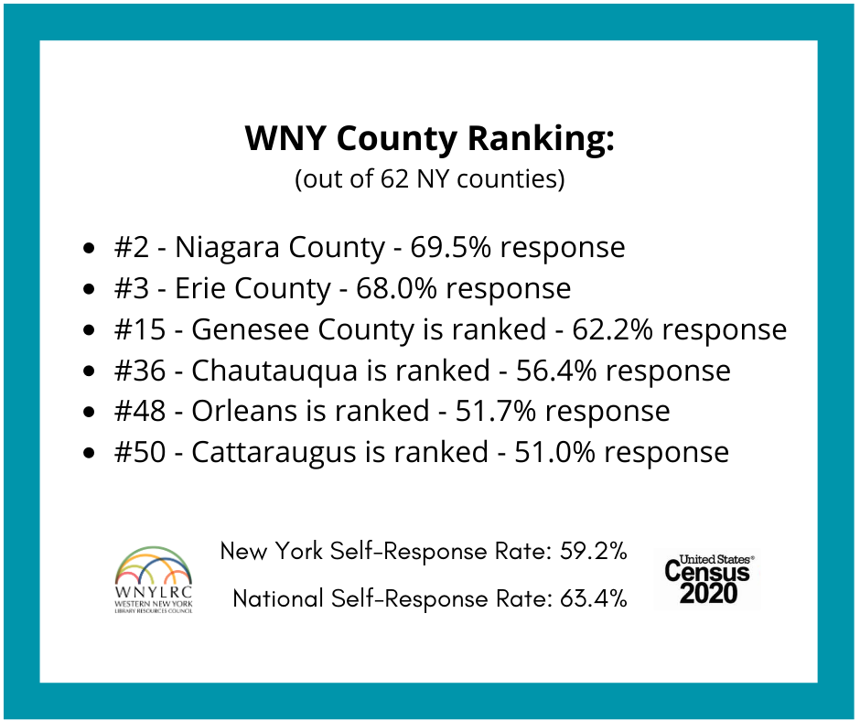
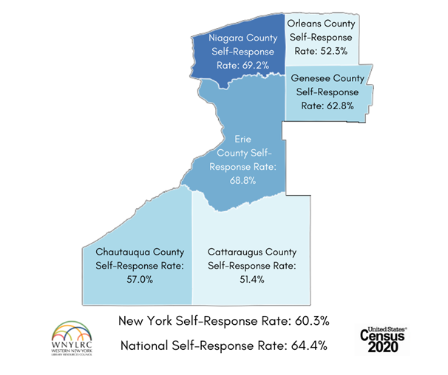
The 2020 Census
Notes:
80% of US households were invited to participate online in the 2020 Census.
This has highlighted where New York State’s connectivity gaps exist at county and municipal levels
NY is ranked at #36 in the nation, with a total of 5,400,000 household responses. In NYS, the response rate has hovered around 60% - from this data it appears as if Erie and Niagara Counties are above both the state and national averages. However….what the data is really telling us...

Slide 4
Here are some select rankings (out of 597 cities):
#17 - Orchard Park - 78.6% response
#20 - Hamburg - 78.3%
#26 - East Aurora - 76.5%
#28 - Lancaster - 77.1%
#31 - Youngstown - 76.6%
#32 - Tonawanda - 76.5%
#35 - Depew - 76.3%
#40 - Alden - 76.0%
#45 - Akron - 75.2%
#47 - North Tonawanda - 75.0%
#77 - Lewiston - 71.4%
#115 - Wilson - 68.8%
#124 - Lockport - 68.5%
#202 - Fredonia - 63.9%
#226 - Allegany - 63.1%
#276 - Olean - 60.6%
#276 - Batavia - 60.6%
#280 - Le Roy - 60.5%
#319 - Cattaraugus - 58.9%
#398 - Niagara Falls - 55.2%
#428 - Medina - 53.4%
#459 - Buffalo - 51.4%
...is that there are wide discrepancies within places like Erie and Niagara Counties in the response rates of the various municipalities and City of Buffalo.
Notes:
Places like Buffalo and Niagara Falls are well below places like Youngstown and Orchard Park
And if we dig deeper...

Slide 5
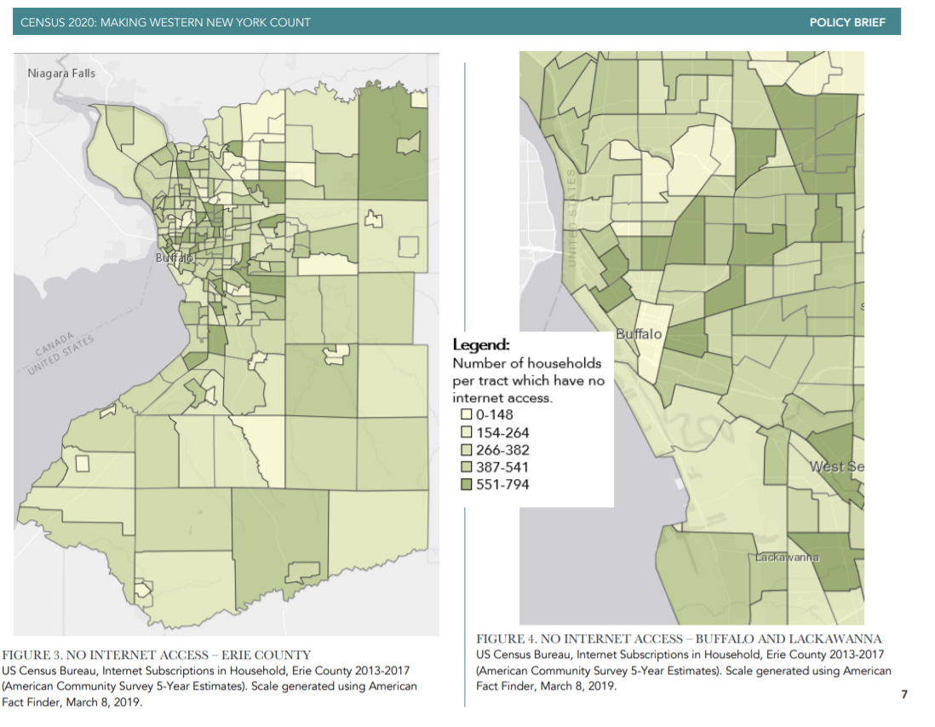
Digital inequity is one more indicator of the socioeconomic divide in our communities
Notes:
...we see that there is a correlation between no/low access to internet and areas of low response rates
The Census tracts with the highest rates of no internet access are found within zip codes of the area’s highest poverty rates - they are also the “hard to count” areas identified by the Census as having the lowest response rates. These areas are also areas with higher populations of people of color and people who are not English-speaking
Of the top ten zip codes with the highest COVID-19 positive rate, five are located within the City of Buffalo (14209, 14208, 14215, 14207, 14211) - two of these are in the “teal” zip codes of Buffalo (least connected - one west, one east). Within Buffalo, the zip codes with the highest rates of COVID-19 have populations that are majority people of color (POC). In city zip codes with the highest COVID-19 rates, poverty rates range from 29% to 40%. The city-wide poverty rate is 30%.
https://ppgbuffalo.org/news-and-events/news/article:05-19-2020-12-00am-diving-into-the-data-covid-19-cases-and-other-local-data/
https://ppgbuffalo.org/files/documents/data-demographics-history/general/census_2020-making_wny_count.pdf

Slide 6
Why Does Digital Equity Matter?
75% of all federal grant dollars are allocated using Census population data
$675 billion annually was allocated nationwide in 2010
$53 billion went to NYS after the 2010 Census
These dollars directly impact our communities in terms of:
Health care (SNAP is second largest federally funded program in US)
Education (school districts)
Employment (Economic Development Grants and Loans)
And other things like Transportation, Local Government and, Manufacturing
Notes:
Digital Inequity is part of the story of income inequities:
Local and state governments heavily rely on federal dollars for programs and services in our communities, including:
Title I Grants, Adult Education, the National School Lunch Program, Head Start and Early Start programs, and Indian Education Grants to Local Agencies, Medicare, the State Children’s Health Insurance Program, the Supplemental Nutrition Program for Women, Infants, and Children (WIC), the Health Centers Program, and Reproductive Health Programs, used to determine Fair Market Rents critical to housing affordability programs and used to predict future trends. Funding is provided for low income renters through Section 8 Housing Vouchers, Low-Income Housing Tax Credits, and other Housing and Urban Development (HUD) programs, Choice Neighborhood Implementation Grants, Community Services Block
Grants, Community Development Block Grants, and the Rural Economic Development Loans and Grant Program. Small Business Loan programs and more.

Slide 7
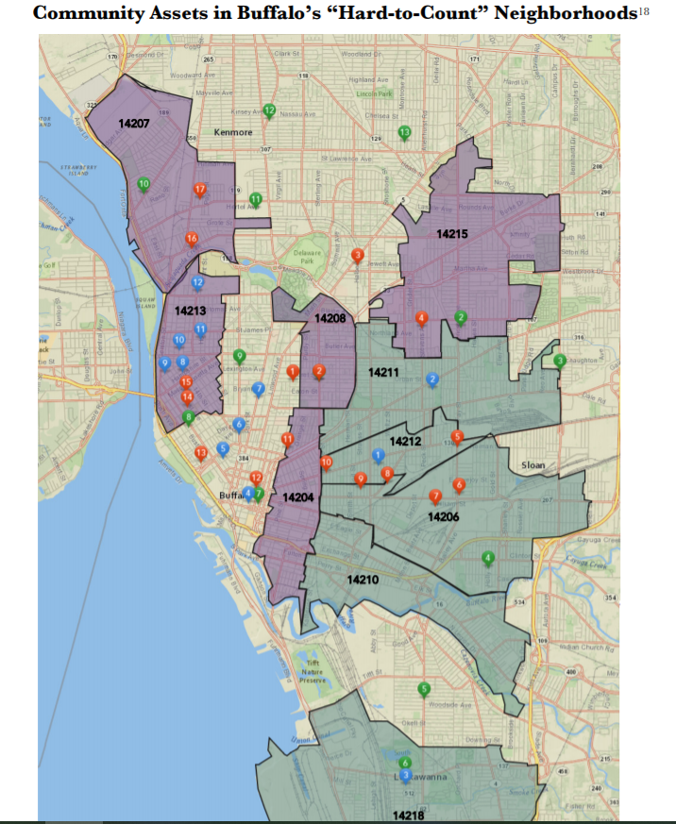
“Community Assets”
Libraries (green) in hard-to-count areas are few and far between, yet they are an essential community asset for helping members of the community access the internet, learn to use devices, learn skills that will allow them to take a more proactive role in their health, education and economic well-being.
We need to do a better job mobilizing Community Assets in addressing digital inequities!
Notes:
https://www.tandfonline.com/doi/full/10.1080/01616841003779718?src=recsys
Red - community groups, blue - immigrant groups, green - libraries
The report (above) states: ...disadvantaged groups were much more likely to use the Internet at a public library than the national average, in particular unemployed persons (three times more likely), and those “not in the labor force” (twice as likely), as well as those earning less than $25,000, those with less than a high-school education, those in female-headed households, and American Indians/Eskimos/Aleuts, blacks, and Hispanics (USDC 1999).
Even more striking, trends of computer use and library computer use by race move in the opposite direction from one another: Asian American and white respondents were most likely to be computer users but least likely to be library computer users, while black, Hispanic, and Native American respondents were less likely to be computer users but more likely to be library computer users. Similarly, among computer users, library computer use is more prevalent among, and more important to, respondents in the lowest income bracket, those with less than a high school education, the unemployed and those who are working part time, and blacks, Hispanics, and Native Americans.

Slide 8
Multidimensional Challenges of Digital Equity
The “Digital Divides” Include:
Variations in technology (equipment)
Variations in autonomy (use) and intensity (frequency)
Variations in skills (mastering new technology and information resources)
Variations in supports (formal and informal)
Variations in purpose (from consumer to producer)
*Ability to use digital resources to address “everyday goals and concerns”
Notes:
https://www.huduser.gov/portal/periodicals/em/fall16/highlight2.html
Local digital and social infrastructures can influence how residents engage with digital resources, including through affecting: the local cost, speed, and availability of Internet connectivity and devices; the available opportunities for training and support that facilitate meaningful digital connectivity. Spaces such as libraries and community organizations can provide access to in-person support, classes and workshops, and social contexts that encourage the development of hands-on digital skills.32 Factors such as segregation and concentrated poverty can also create disparities in Internet access and use even in areas where broadband networks are available.

Slide 9
The Digital Health Navigator: Health Equity through Library Partnerships (HELP)
Health Information Literacy is a Social Determinant of Health
Health literacy is the degree to which individuals have the capacity to obtain, process, and understand basic health information and services they recognize as important to them in making appropriate health decisions.
Librarians will be able to teach and/or support the tech and information literacy skills needed to access telehealth platforms
Patrons are connected to the internet, have access to devices, and technical support to utilize telehealth and other digital health tools to keep themselves safe during the COVID-19 pandemic and to manage their chronic illnesses.
Notes:
Developing health literacy, especially in underserved areas, will have direct benefits (immediate access to doctors and health centers, consistent treatment for chronic illnesses, informing on healthy eating/living, etc.) as well as indirect benefits (such as eliminating the potential financial burdens of having to travel to appointments as well as taking time off from work to go to appointments; accessing remote sources for food choices, etc)

Slide 10
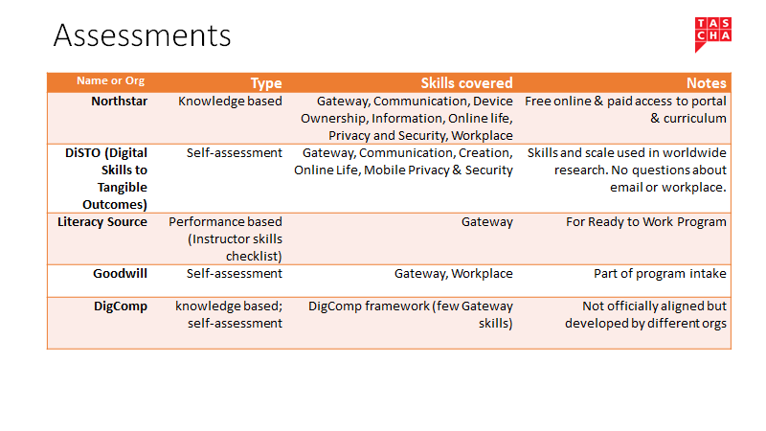
Notes:
Examples of digital skills training programs working in other areas of the country

Slide 11
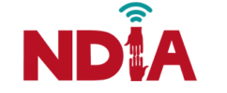
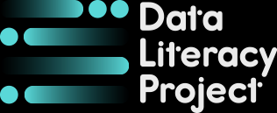
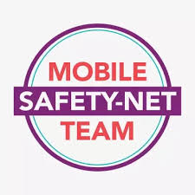
BROADBANDNOW
Notes:
National and local organizations with digital inclusion as a focus of their work

Slide 12
What can we do?
Keep tracking impacts, differences, and changes - and publicize the inequities
Internet speed tests across zip codes
Anecdotal stories that helps “humanize” data
Survey availability of devices, broadband, training in public places
Let local, state and national government know of our awareness of the inequities
Band together to address the issues - Form a Digital Equity Coalition in WNY!

