Slide 1


A United Way Worldwide Initiative
Led Locally by United Way of Buffalo & Erie County

Slide 2
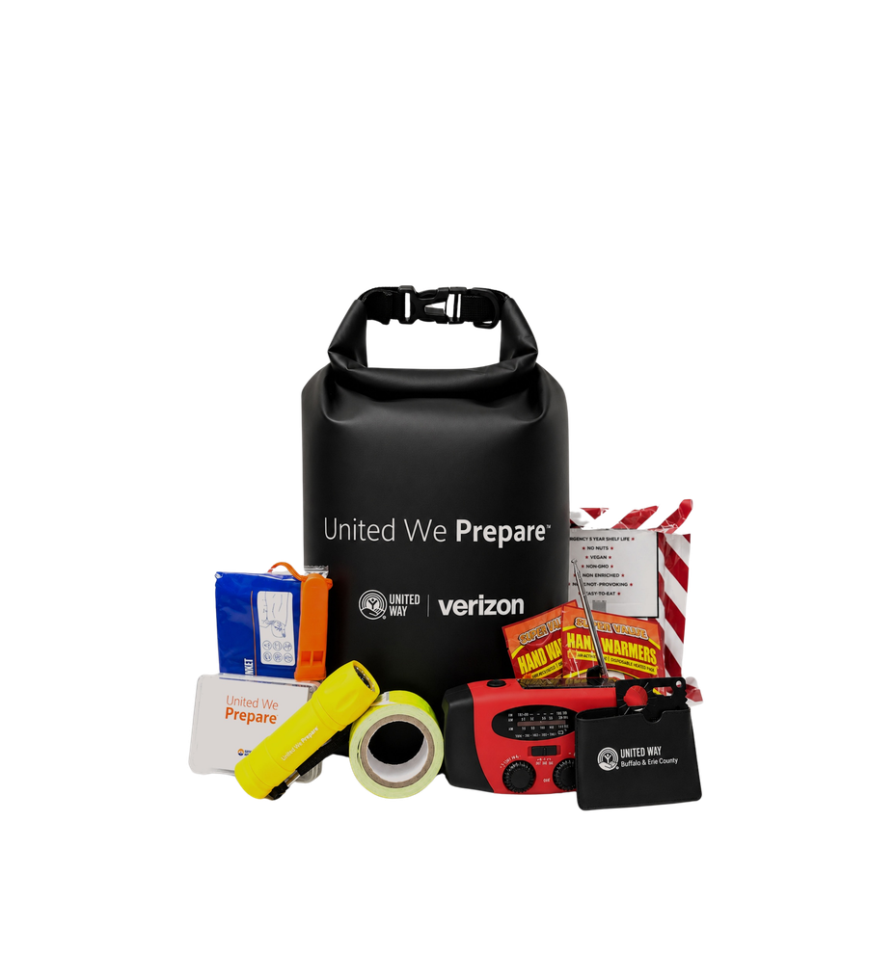

WHY IS THIS IMPORTANT?
We can’t predict the future, but we can be ready for it. United Way works in communities around the world to learn from the lessons of the past and strengthen our capacity to respond.
We live where we serve, so we know the resources people count on and the gaps that can leave them vulnerable.
Notes:
Introduce ARC volunteer

Slide 3
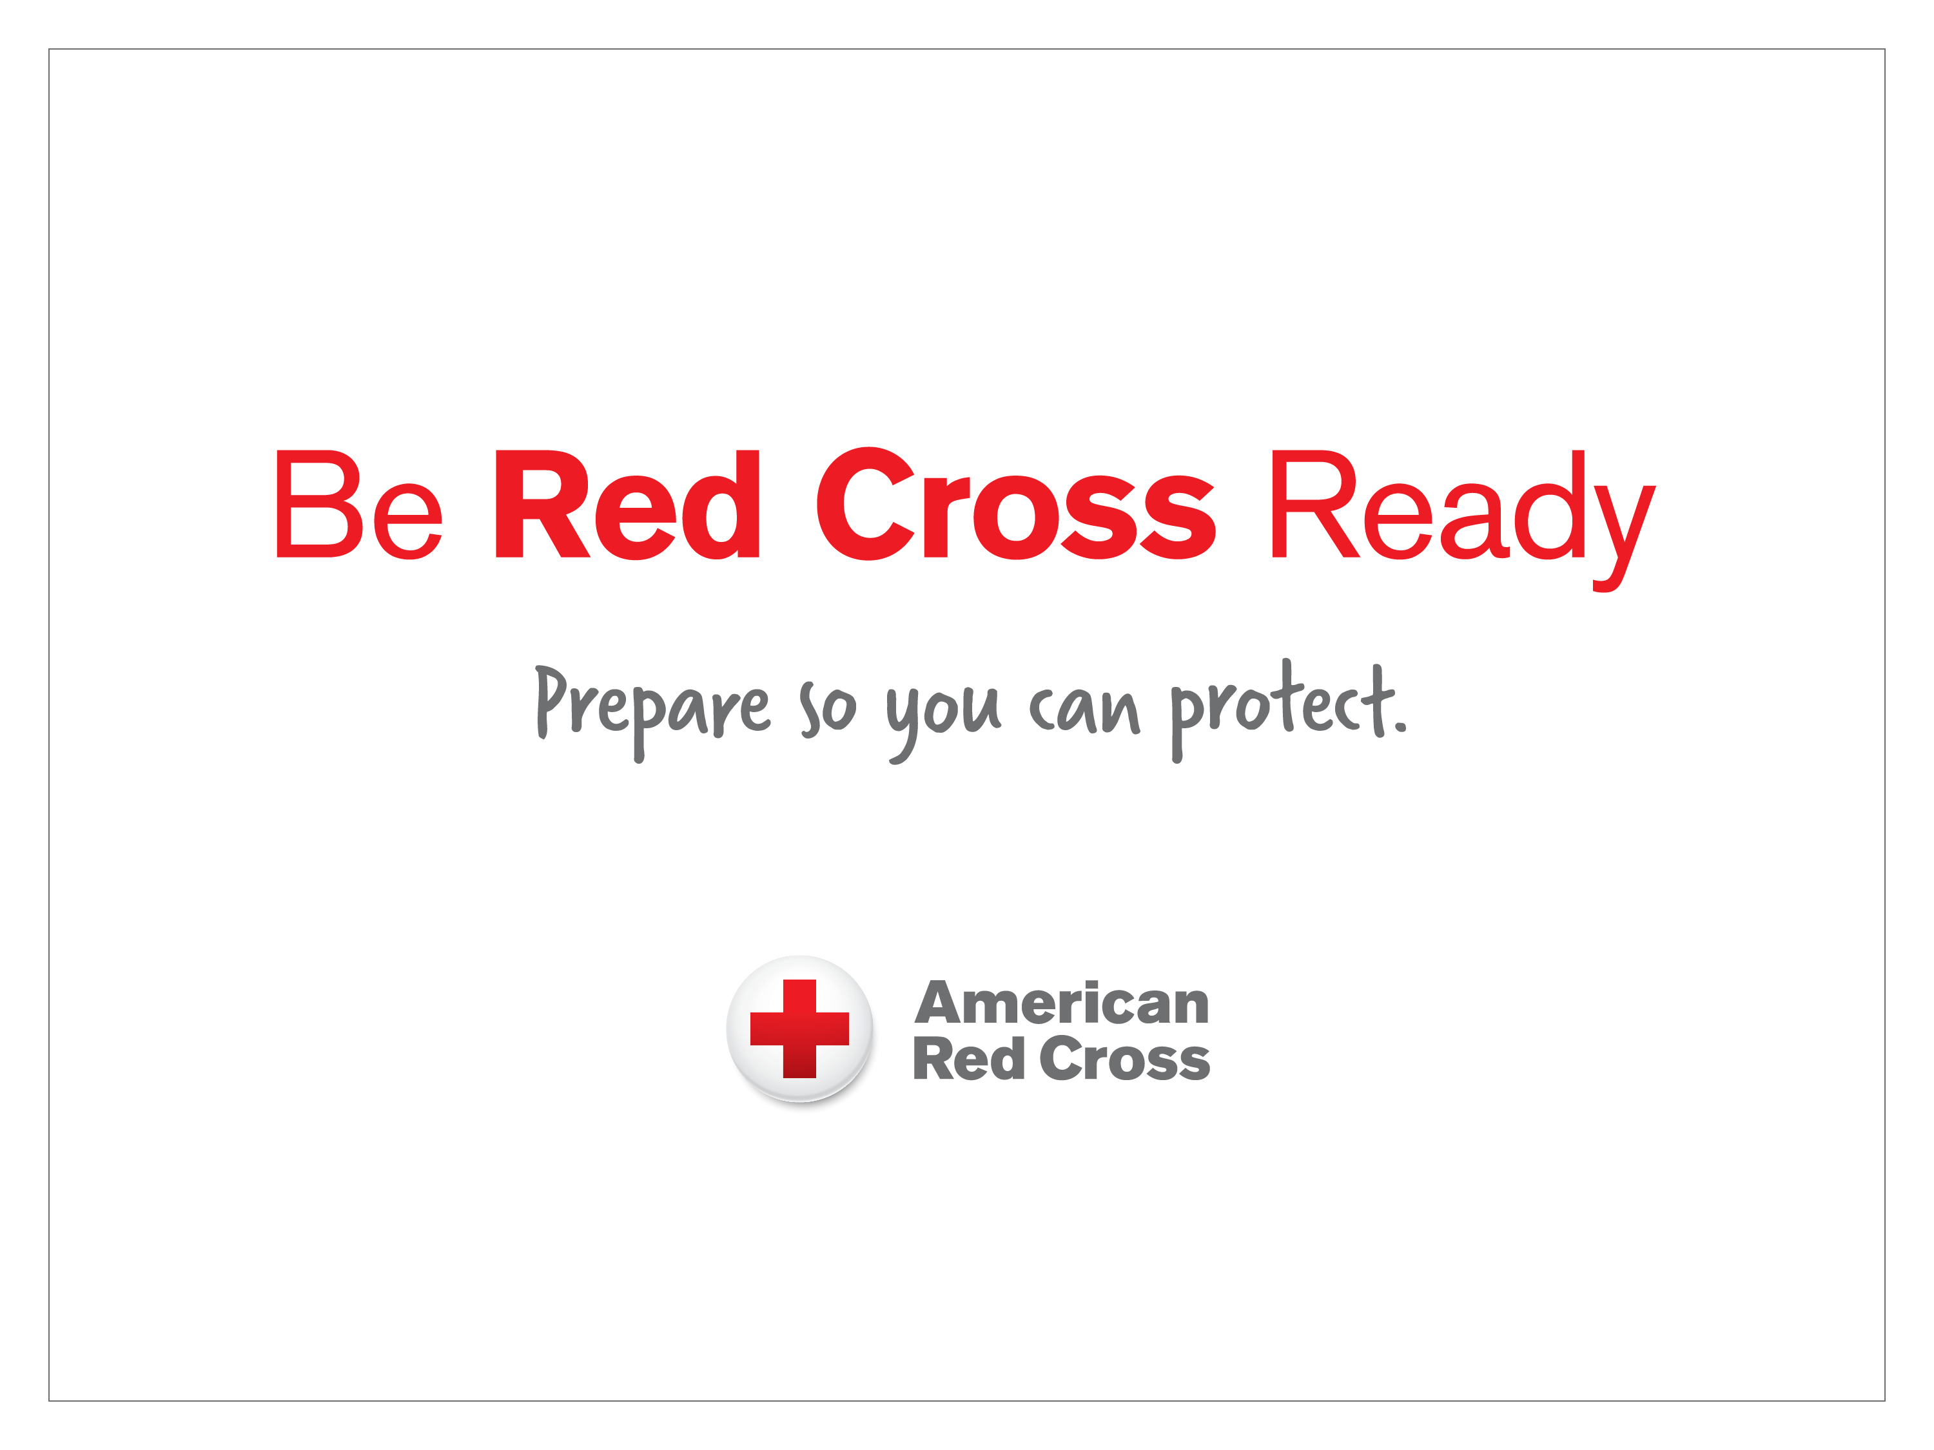
Preparedness Essentials
Notes:
Welcome to this Be Red Cross Ready presentation. Thank you for your interest and for joining us today.
My name is …
Speaker Note: If time permits, ask participants to introduce themselves.
Before we get started, let’s briefly go over some safety and logistics information:
Review location’s safety information:
Location of emergency exits
Designated meeting place in the event of a fire
Location of AED
Other safety information (Customizable)
Review logistics, may include:
Location of bathrooms
Schedule for breaks
Smoking areas
Cell phones are only to be used outside of the classroom - please silence them.
Listen respectfully to others.
Any other location-specific information, i.e. parking restrictions, etc.
If you’ve set aside seats for those with low vision or difficulty hearing, advise them to “please take a seat in the front if you like to hear or see the presentation better.”

Slide 4






Odds Are That Disaster Will Strike
Disasters happen often and sometimes without warning.
They can affect any community.
It’s a disaster if:
  Normal response systems are overwhelmed
  People are hurt
  Property is damaged or destroyed
Notes:
Preparedness Essentials
The fact is that disasters happen:
They happen often.
They happen with little or no warning.
They happen anywhere and at any time.
Every year, communities across the United States face disasters.
Hurricanes, Tornadoes, Floods, and Winter Storms
Wildfires burn thousands of square miles
And home fires impact thousands of households

Slide 5
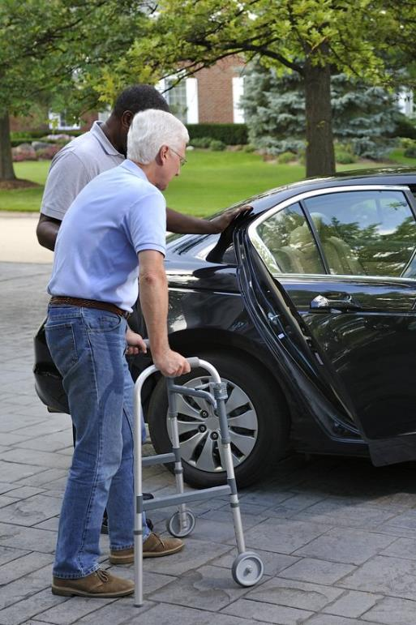
It Is Up To You To Be Ready
Do not count on receiving help right away.
You must be prepared to help:
  Yourself
  Your household
  Neighbors
  Older adults
Notes:
In any of the disasters that we have talked about, a lot of people assume that someone else will be there to help.
However, resources just aren’t there to support everyone immediately.
First responders, disaster organizations, government agencies, and hospital emergency rooms do their best.
But, on average, these groups are staffed and prepared for normal day-to-day operations and resources may be limited during a disaster.
The truth is we will have to depend on ourselves first. Why? Because:
Roads may be impassible.
Utilities may be unavailable.
Hospitals and first responders could be overwhelmed.
And banks, grocery stores, gas stations, pharmacies, schools, and workplaces may be closed for days.
You may also need to help others such as members of your household, neighbors or those who have functional or access needs
Do not count on receiving help right away.
---------------
Source:
American Red Cross Small Business Continuity & Resilience Workshop
Preparedness Essentials

Slide 6

You Can Prepare
Each of us can prepare ourselves and our households for any disaster.
Preparing helps us:
Stay safe
Adapt to challenges
Recover quickly
Notes:
All of us can and should be prepared to help ourselves and our households.
Will preparation be perfect? No.
Will preparation make things quick, easy, or painless? Not always.
But planning and preparation will help you to be safe and recover quickly.
ASK: What does it mean to be prepared?
Speaker Note: Encourage participants to offer ideas. Allow one to two minutes for responses.
Regardless of the responses, summarize the discussion by defining preparation as follows:
When we are prepared we can:
Take protective actions to be safe.
React in the right ways.
Adapt to tough challenges.
And recover quickly from difficulties.
---------------
Source:
Resilience definition adapted from The Road to Resilience, American Psychological Association
Preparedness Essentials

Slide 7
Notice Vs. No Notice Events
Notice events: events that have some advanced warning such as snowstorms, hurricanes etc.
  Have your kit ready, shelter in place
No Notice Events: No advanced warning such as home fires. – Get out now!!!
  Do not take your preparedness kit***

Slide 8

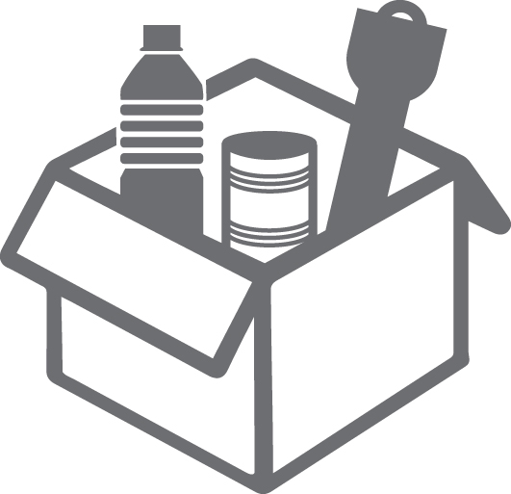
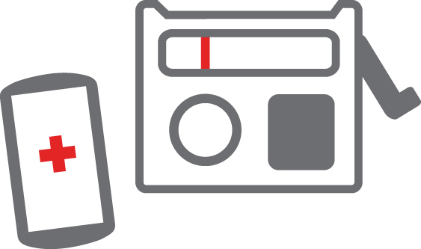
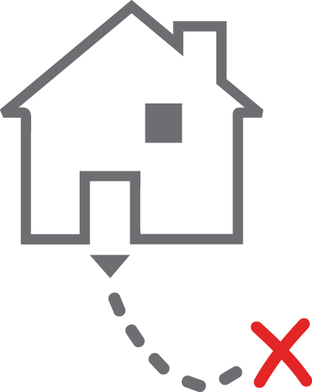
Be Red Cross Ready
Get a Kit
Be Informed
Make a Plan
Notes:
So, what does it take to be prepared?
To Be Red Cross Ready, you need to do three things:
Get a kit – Your kit should contain the supplies you will need at home or can easily carry with you if you have to evacuate.
Make a plan – You should identify the steps you will take to respond to specific disasters. For each disaster, decide who in your household will do what, where you will go, and how you will communicate with each other.
Be informed – Finally, it is important that you are informed. Learn now about how you will get information if a disaster occurs and what resources are available in your community. This will allow you to quickly respond – to help yourself, your household, and your community.
Now, let’s look at each of these in more detail.
---------------
Source:
American Red Cross Be Red Cross Ready Preparedness Fact Sheet
Preparedness Essentials

Slide 9
Get a Kit
  Household kit – supplies for 3 days, 2 weeks is better
  Go-bag – mobile version, supplies for 3 days in case you need to evacuate quickly
  Supplies for each member of household
  Customize for personal needs and disasters common to your area
Notes:
If a disaster strikes in your community, you might not have access to food, water, electricity, a medical facility, or even a drugstore.
Preparing a disaster kit for your household is an important step to keep everyone safe and healthy during a disaster.
Consider assembling two kits of supplies:
In one kit put everything you will need to stay at home for at least three days. As you are able, work to gather enough supplies in this kit to last for two weeks.
The other kit (often called a “go bag”) should be a lightweight, smaller version that you can take with you if you have to leave your home quickly. It should contain everything that you would need to be on your own for three days. Based on the needs of the members of your household, this could be one kit for the entire household or separate kits for each member.
Customize the kits to meet everyone’s personal needs and the disasters that are common to your area.
---------------
Source:
American Red Cross Be Red Cross Ready Preparedness Fact Sheet
Preparedness Essentials

Slide 10
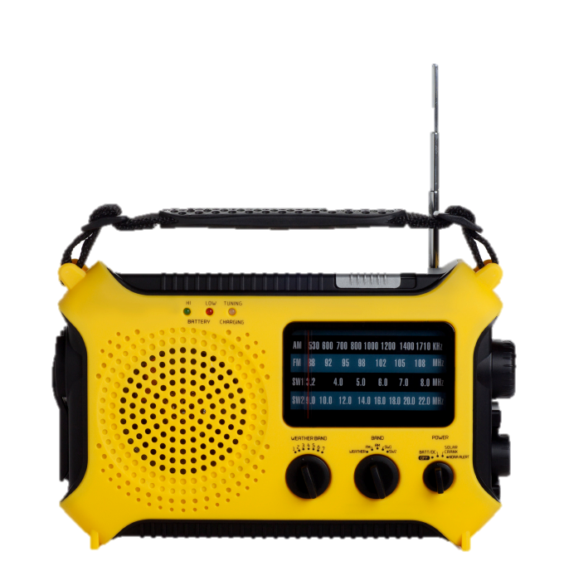

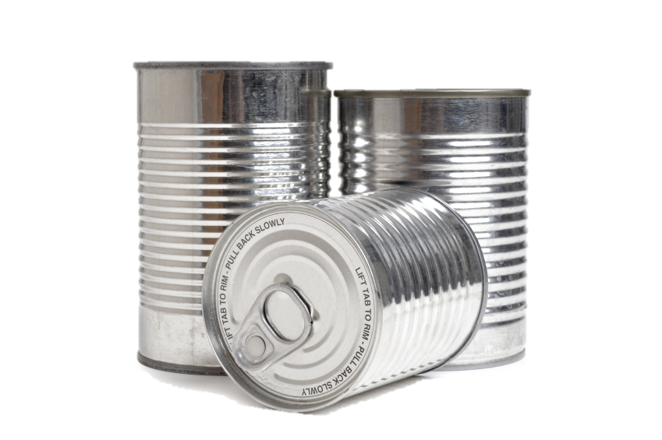

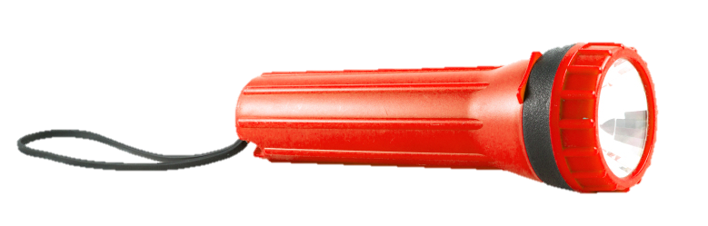
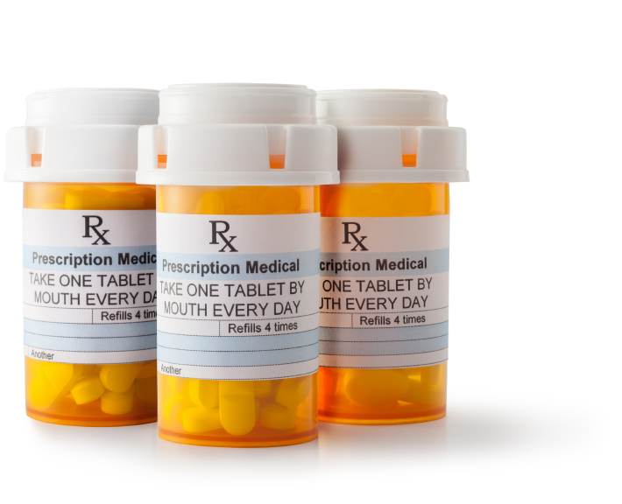
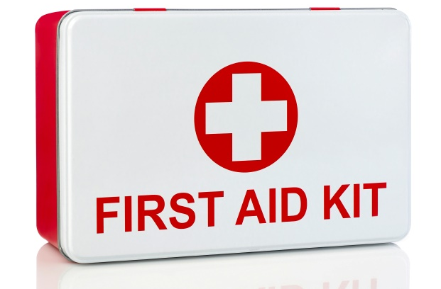
Gather The Essentials
What is essential every day
Needs of every household member
Keep it fresh
Script requires PERSONALIIZATION
1 gallon per day, per person
Notes:
To build your kit, think about what you use on a daily basis and what you might do if those resources were limited or not available. Start with the basics – food, water, clean air, and any life-sustaining items members of your household need to maintain health, safety, and independence.
Basic supplies include:
Nonperishable, easy-to-prepare food items, a manual can opener, and water. Remember, you may be without electricity and you may only have the amount of water that you have stored.
ASK: How much water do you think you need to store?
Speaker Note: Allow for a few responses.
Regardless of responses, provide the following:
You should have at least one gallon of water per person, per day – half for drinking and half for sanitation. You may need more than this depending on the specific needs of those in your household and the environment in which you live.
Speaker Note: If you are in a particularly hot region, provide an example of why more water may be necessary (at least at certain times of the year).
You will also want a flashlight and a battery-powered or hand-crank radio.
If possible, get a NOAA Weather Radio so that you can receive important weather statements.
You may also sign up in advance to receive emergency notifications from your local emergency services.
Extra batteries
A first aid kit
A seven-day supply of medications and medical items
Also keep a copy of prescriptions, dosage, and treatment information.
Include battery backup power for power-dependent mobility devices, oxygen, and other assistive technology needs.
Talk with your doctor or pharmacist about other actions you can take.
A multi-purpose tool
Sanitation and personal hygiene items
Copies of personal documents such as medication lists and important medical information, proof of address, deed/lease to your home, passports, birth certificates, and insurance policies
Current digital photos of loved ones – remember to update these every six months, especially for children
A cell phone and charger
Household member and emergency contact information
Extra cash
At least one emergency blanket
Maps of the area – you may not have access to maps on your cell phones or computers
Don’t feel overwhelmed by this list! Preparedness is a process that takes a little time. Consider building your kit one step at a time. Focus on adding a few items each week until your kit is complete.
Don't forget to make a kit for your pets or service animals. Be sure to include food, water, identification tags, and other necessary supplies.
Speaker Note: Provide an example of an item that you may add to customize your kit (such as something for a household member with a specific need or because of a particular disaster).
No matter what is in your kit, it's important that everything works when disaster strikes. Check the expiration dates of food, medicines, and batteries at least twice per year. Replace anything that has expired or is near expiration.
---------------
Sources:
American Red Cross Be Red Cross Ready Preparedness Fact Sheet
American Red Cross Small Business Continuity & Resilience Workshop
www.fema.gov/media-library-data/1440775166124-c0fadbb53eb55116746e811f258efb10/FEMA-ReadySpNeeds_web_v3.pdf
Preparedness Essentials
Script requires PERSONALIIZATION

Slide 11
Customize Your Kit
Add to your kit based on:
  Health or medical needs
  Pets and service animals
  Items that bring you comfort when stressed (playing cards, photos, books, games, etc.)
  Disasters common to your location
Notes:
We've talked about the essentials for your kit. Now we need to talk about how you might need to customize your kit based on the specific needs of your household and on the types of disasters that are possible in this area.
For example, there are weather radios with text display and a flashing alert so that you can stay informed even if you have difficulty hearing.
ASK: What other things might you want to add based on the specific needs of your household?
Speaker Note: Encourage participants to offer ideas. You may want to have someone record the responses on a flipchart or whiteboard.
Regardless of the responses, summarize the discussion with the following:
Those are some great responses. You want to always be able to store what you need in your kit. So collect the following items, as appropriate, from around your home as soon as you become aware of a potential disaster or if you need to evacuate:
Medical supplies – such as syringes, glucometers, diabetic testing strips, lancets, ostomy bags, and catheters.
If you undergo routine treatments or receive regular services, talk with your service provider about their disaster plans.
Assistive or adaptive devices, including supplies for service animals
Communication boards or tables
Baby supplies like bottles, formula, baby food, and diapers
Pet supplies – such as a collar, leash, ID, food, bowls, and a pet carrier
An extra set of vehicle keys and house keys
ASK: Are there additional supplies that you might need because of the types of hazards we may face here?
Speaker Note: Encourage participants to offer ideas. You may want to have someone record the responses on a flipchart or whiteboard.
Regardless of the responses, summarize the discussion with the following:
Additional supplies to keep at home or in your kit include:
A whistle
A respirator
Matches
Rain gear
Towels
Work gloves
Tools and supplies for securing your home
Extra clothing, a hat, and sturdy shoes
Plastic sheeting to keep things dry
Duct tape
Scissors
Household bleach
Entertainment items – items that bring you comfort when stressed (playing cards, photos, books, games, etc.)
Blankets or sleeping bags
Sunscreen and insect repellent
These additional items may provide additional protection from the elements and help with recovery.
---------------
Source:
American Red Cross Be Red Cross Ready Preparedness Fact Sheet
Preparedness Essentials

Slide 12
Home Kit | Car Kit
Food-nonperishable - doesn’t need to be cooked | Granola bars or other no perishable food items
Water | Water
Extra Medication/Medical Supplies | Flashlight
Radio | Extra Coat, Hat, Gloves
Flashlight(s) | Blanket
Portable Charger | Bright colored flag or object to mark car if stranded
Hand Sanitizer | Shovel
Utensils | First Aid Kit
Batteries | Portable Charger
List with important phone numbers or other info | Jumper Cables
Extra Pet food | List with important phone numbers or other info
Femnine products | Tissues/napkins
Activities for Kids
Formula
Diapers

Slide 13

Make a Plan
Things to consider:
Likely disasters
Household members who travel
Household members with access or functional needs
Pets and service animals
Notes:
Knowing the hazards likely for your area, you can now make a plan.
Different hazards require you to take different actions. For instance, during a tornado, you need to move to a basement, storm cellar, or an interior room on the lowest floor with no windows. For a home fire, everyone needs to evacuate immediately and meet at their designated safe meeting place.
Talk with everyone in your household about how to prepare for and respond to the hazards that are most likely to happen where you live, learn, work, and play.
Identify responsibilities for each member of your household and plan to work together as a team.
If a household member is in the military or has extended business travel on a regular basis, plan how you will respond if they are away.
Individuals with access and functional needs will need to prepare a bit differently.
Create a personal support network that can help you plan and provide assistance if a disaster happens. Remember not to depend on just one person – include a minimum of three people in your network.
Complete a personal assessment of functional abilities and possible needs during and after a disaster situation.
Make sure you practice your disaster plans with your personal support network at least twice a year.
Don’t forget to think about what you will do with your pets. Most American Red Cross shelters cannot accept pets because of health and safety concerns and other considerations. However, service animals are allowed in Red Cross shelters. Contact your local emergency management agency for a list of pet-friendly shelters.
---------------
Source:
American Red Cross Be Red Cross Ready Preparedness Fact Sheet
Preparedness Essentials

Slide 14
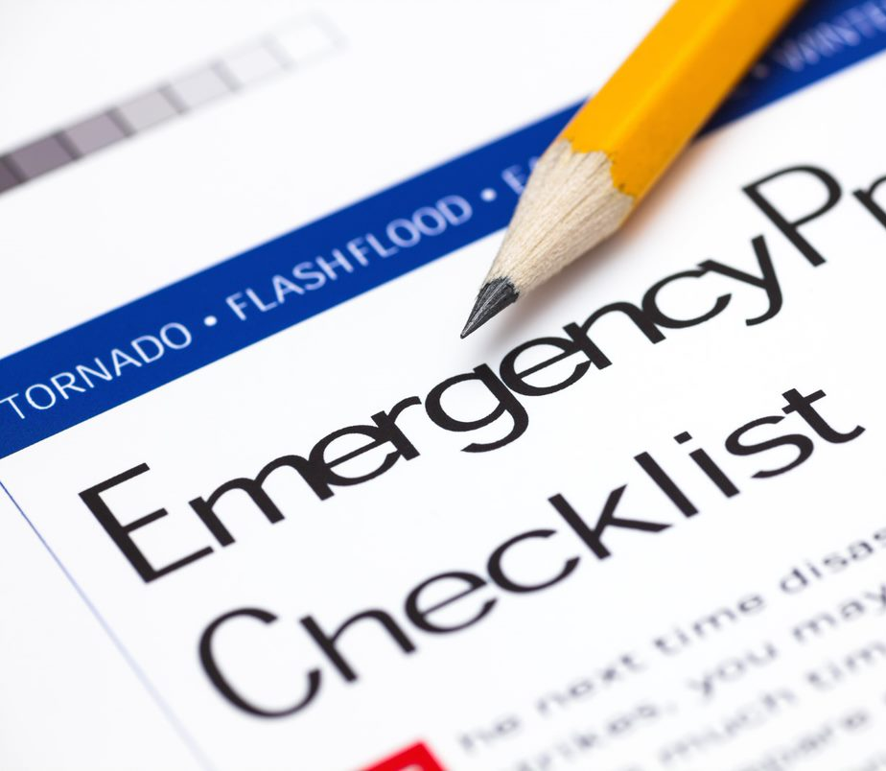
Include the Right Details
  How to evacuate
  Where to meet
  How to communicate
  Important records
  Where you will stay
  Shelter in place
Practice your plan.
**Have someone outside your area code as a contact
Notes:
Your plan should include key details.
Identify two ways to evacuate from every room in your home, your neighborhood, or your town, depending on how big the disaster is.
Plan what to do in case you are separated during a disaster:
Choose two places to meet –
One right outside your home in case of a sudden emergency, such as a fire;
And one outside your neighborhood, in case you cannot return home or are asked to evacuate.
Don’t forget to consider any transportation challenges that might be encountered by individuals who use mobility assistive equipment or those who don’t have access to a vehicle.
An important part of your disaster plan is how you will communicate, especially if you and members of your household are not together when disaster hits. Make sure each member of your household has contact details for everyone and that they keep that information with them at all times.
Determine now, ahead of time, what important records you will need and where they should be stored, such as a safety deposit box or fireproof box. Remember, it's a good idea to keep copies in your kit.
If you are without power for an extended period of time or have to evacuate, it will be important to have a place to stay. It's a good idea to find a place close if you have to leave because of something like a home fire and some place farther away in case the entire community or region is impacted by something like a hurricane, flood, or tornado.
And, if the authorities encourage you to shelter in place, ensure that all household members are aware of any actions they must take and where in the home they should go.
Once you have your plans developed, practice, practice, practice. Review plans with everyone in your household. If anyone has a personal support network or requires assistance, be sure to review the plan with them as well. Practice with everyone – members of your household, your personal support network, and anyone else you may rely on in an emergency or disaster.
---------------
Source:
American Red Cross Be Red Cross Ready Preparedness Fact Sheet
Preparedness Essentials

Slide 15
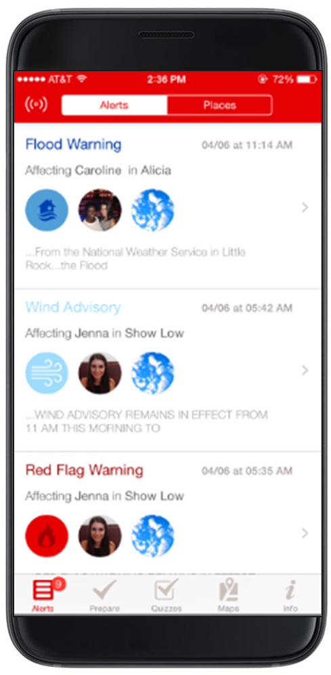
Be Informed
Identify how you will get information
Understand weather alerts
Follow instructions from authorities
Know your neighbors
Know what to do when travelling
Notes:
We talked a little about being informed when we talked about how important it is to know what hazards you should prepare for, but there is more to it. It’s an ongoing process.
Here are some of the things you should do:
Know how your community warns of a coming disaster. Some communities have outdoor sirens. Others depend on media and smartphones to alert residents of severe weather or dangerous events.
Use a NOAA Weather Radio or listen to a local station on a battery-powered radio or television for updated information. This is allows you access to important information even if the power is out. You may also want to consider having a list of the local stations in your disaster kit.
Understand the difference between a watch and a warning, and how to respond to each.
A watch means there is the potential for a specific type of weather event or hazard. Be alert. Start making preparations, monitor weather and local emergency broadcasts, and be ready to take immediate action if conditions worsen.
A warning means that a specific type of severe weather or hazard is imminent or already occurring. You should take immediate action to protect yourself when a warning is issued.
Learn about an area before you travel there. Know what disaster risks they face and how to protect yourself. For instance, when visiting an area known for earthquakes, know what to do when the shaking starts and after it stops.
Download the Red Cross Emergency! App. It lets you monitor 35 different severe weather and emergency alerts.
Know your neighbors. They can be good resources of community information or if someone needs help.
---------------
Source:
American Red Cross Be Red Cross Ready Preparedness Fact Sheet
Preparedness Essentials

Slide 16
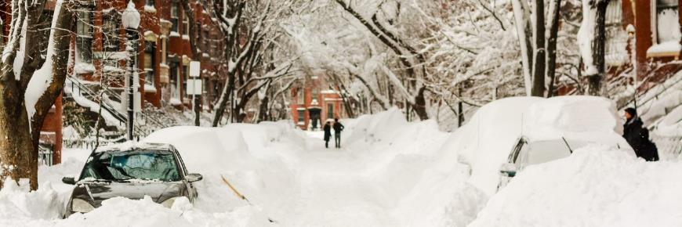
Winter Storms
Winter storms can impact every state
Snow, sleet, freezing rain, and ice
Dangerous driving conditions
Risk of extreme cold
Notes:
Winter storms are weather events that can bring snow, sleet, and freezing rain. They can affect communities throughout the United States and its territories. Even tropical places and southern cities such as Atlanta and Dallas have been paralyzed by snow and ice.
Sometimes, winter storms can become blizzards. Blizzards are characterized by strong winds and blowing snow, which can cause whiteout conditions to develop, making driving especially dangerous.
The extreme cold air that accompanies all winter storms, combined with strong winds, increases the risk of frostbite and hypothermia.
Each year, hundreds of people in the United States are injured or killed by exposure to cold, vehicle accidents on wintry roads, and fires caused by the improper use of heaters.
---------------
Sources:
ARC Winter Storm Safety site ‒ www.redcross.org/get-help/how-to-prepare-for-emergencies/types-of-emergencies/winter-storm
National Weather Service Winter site ‒ www.weather.gov/safety/winter
National Weather Service Cold Weather Safety ‒ www.weather.gov/safety/cold
Winter Storms

Slide 17
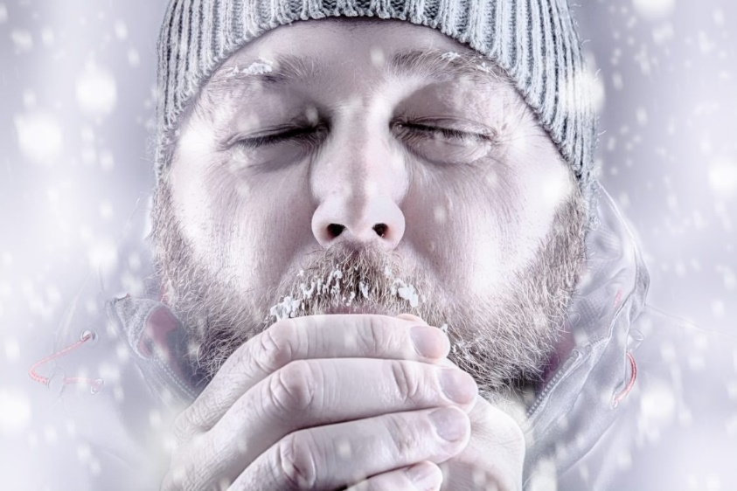
Signs of Frostbite
Numbness
Waxy appearance
Discoloration
Cold to the touch
Avoid Frostbite
Know the windchill
Warm fluids
Stay active
Limit time outside
Dress in layers
Notes:
Frostbite occurs when parts of the body become so cold that they begin to freeze. Frostbite usually affects fingers, toes, the nose, and earlobes.
When a body part becomes too cold, it may begin to show signs of frostbite. Be on the lookout for:
Lack of feeling in the affected area
Skin that appears waxy
Skin that is discoloring and becoming flushed, white, gray, yellow, or blue
Skin that is cold to the touch
We’ll talk later about what you can do to treat frostbite. There are some simple steps you can take to avoid frostbite.
Be aware of wind chill.
Drink plenty of warm fluids, but avoid caffeine and alcohol.
Stay active to maintain body heat.
Limit time outside during cold temperatures.
Dress appropriately – wear layers, hats, and gloves.
---------------
Source:
ARC Winter Storm Site ‒ www.redcross.org/get-help/how-to-prepare-for-emergencies/types-of-emergencies/winter-storm#After
Winter Storms

Slide 18

Frostbite Treatment
Move to a warmer place.
Do NOT rub skin or pop blisters.
Remove wet clothing.
Soak in warm water.
Wrap with sterile gauze.
Seek medical attention.
Notes:
If you notice any signs of frostbite, immediately move the person to a warmer place and remove any wet clothing.
Be very gentle and never rub or pop blisters on the frostbitten area.
You can warm the affected area by soaking it in water that is 100º to 105º Fahrenheit until the area appears red and feels warm.
Once the affected area is warm, loosely bandage the area with sterile dressings. Make sure to place sterile gauze between frostbitten fingers and toes to keep them separated.
Most importantly, seek professional help as soon as possible and do not let the frostbitten area refreeze.
---------------
Source:
ARC Winter Storm Site ‒ www.redcross.org/get-help/how-to-prepare-for-emergencies/types-of-emergencies/winter-storm#After
Winter Storms

Slide 19



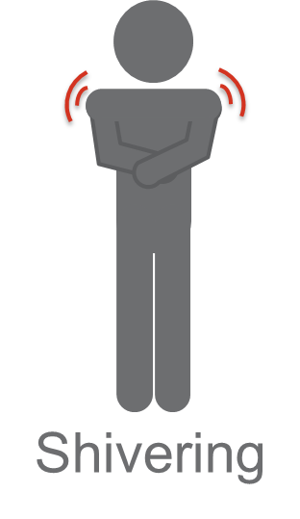
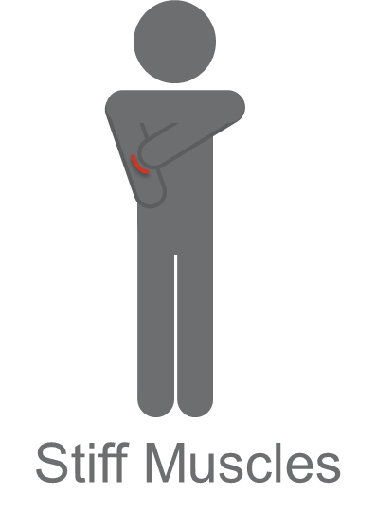
Signs of Hypothermia
Notes:
Hypothermia is a serious condition that occurs when the body loses heat very rapidly and can be life or limb threatening. Be on the lookout for someone who:
Has become confused
Is having difficulty speaking
Can’t stop shivering
Is overcome with sleepiness
Has developed stiff muscles
The steps to avoiding or preventing hypothermia are the same as those for frostbite.
Be aware of wind chill.
Drink plenty of warm fluids but avoid caffeine and alcohol.
Stay active to maintain body heat.
Limit time outside during cold temperatures.
Dress appropriately – wear layers, hats, and gloves.
Be mindful of the very young and older adults, as they may have difficulty keeping warm in cool or cold conditions.
---------------
Sources:
ARC Winter Storm site ‒ www.redcross.org/get-help/how-to-prepare-for-emergencies/types-of-emergencies/winter-storm#After
National Weather Service Winter Safety site ‒ www.weather.gov/safety/winter
Winter Storms

Slide 20
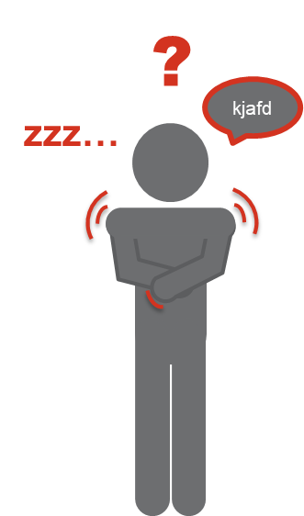
Hypothermia Treatment
Call 911 immediately.
Move to a warmer place.
Remove wet clothing.
Warm with blankets.
DO NOT put a hypothermic person in the bath or shower
Notes:
If you notice any of signs of hypothermia immediately call 911 and gently move the person to a warmer place.
Remove any wet clothing that the person is wearing and slowly begin to warm the person with blankets until emergency medical professionals arrive.
Do not put a hypothermic person in a warm bath or shower, as it may warm them too quickly.
---------------
Sources:
ARC Winter Storm Site ‒ www.redcross.org/get-help/how-to-prepare-for-emergencies/types-of-emergencies/winter-storm#After
National Weather Service Winter Safety site ‒ www.weather.gov/safety/winter
Winter Storms

Slide 21
Staying Safe in Your Vehicle
Remain in the vehicle.
Display a trouble sign.
  This can be done with bright colored objects to ensure visibility of you/your vehicle
Call for help.
Run engine for short periods to heat the car.
  Ensure your exhaust is clear**
Move around in car.
Huddle with others for warmth.
Notes:
If you become stranded in your car during a winter storm:
Stay in your vehicle and wait for help.
Display a trouble sign to indicate you need help. Hang a brightly colored cloth (preferably red) on the radio antenna and raise the hood after snow stops falling.
Run the engine occasionally to keep warm. Turn on the engine for about 10 minutes each hour (or 5 minutes every half hour).
Running the engine for only short periods reduces the risk of carbon monoxide poisoning and conserves fuel.
Use the heater while the engine is running.
Keep the exhaust pipe clear of snow, and slightly open a downwind window for ventilation.
Do light exercises to keep up circulation. Clap your hands and move your arms and legs occasionally. Try not to stay in one position for too long.
If there is more than one of you, huddle together for warmth.
Use newspapers, maps, and even the removable floor mats for added insulation. Layering items will help trap more body heat.
Watch for signs of frostbite and hypothermia.
ASK: Why is it important not to sleep for long periods in a stranded vehicle?
Speaker Note: Wait for participants to offer their guesses. Regardless of the responses, answer with:
If you are not awakened periodically to increase body temperature and circulation, you can freeze to death.
If there is more than one person in the vehicle with you, take turns sleeping so you can wake each other and also keep watch for help.
---------------
Source:
ARC Winter Storm site ‒ www.redcross.org/get-help/how-to-prepare-for-emergencies/types-of-emergencies/winter-storm#During
Winter Storms

Slide 22
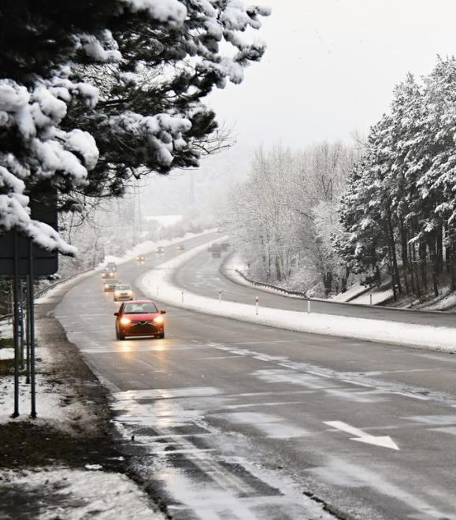
After a Winter Storm
Let others know you’re safe.
Use extra care while driving.
When in doubt, throw it out!
Offer assistance where possible.
Monitor local news and NOAA radio.
Notes:
Winter Storms
Once the winter storm has passed, it is important to care for yourself, members of your household, and even friends and neighbors.
Continue to take care of yourself and members of your household:
Avoid driving and other travel until conditions have improved. If you must drive, use extra care and have a winter survival kit in your vehicle.
Use caution when clearing snow and take frequent breaks to warm up. Heart attacks, often due to overexertion from shoveling heavy snow, are a leading cause of death during the winter and are responsible for nearly 100 deaths every winter.
If you lost power, check refrigerated food for spoilage. If in doubt, throw it out.
Pay attention to how you and members of your household are experiencing and handling stress.
Help people who require assistance, including infants, older adults, individuals with access or functional needs, those with medical needs, and the people providing personal care assistance.
Be sure to stay informed by listening to local news or a NOAA Weather Radio for updated information and instructions.
Pay particular attention to any continuing snowfall, icing, rainfall, or flooding.
---------------
Source:
ARC Winter Storm Safety site ‒ www.redcross.org/get-help/how-to-prepare-for-emergencies/types-of-emergencies/winter-storm

Slide 23
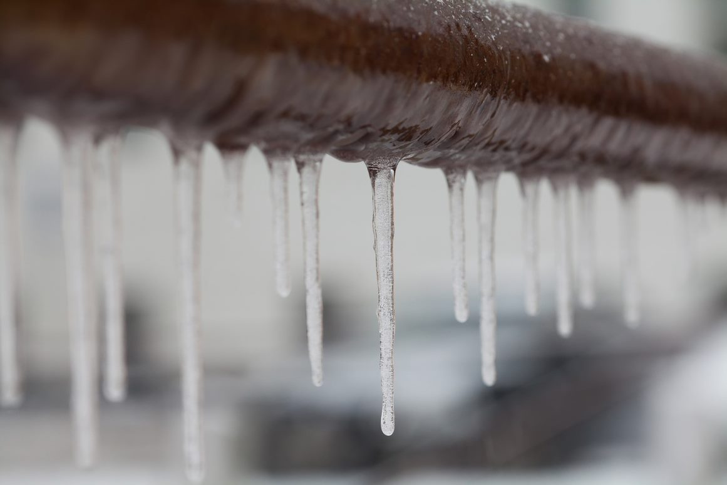

Protect Your Home
Prevent frozen pipes.
Add insulation to keep cold air out.
Ensure heating equipment is properly ventilated.
3 feet from the heat!
Keep extra heating material on hand.
Generators can be a valuable tool but make sure they are outside and properly ventilated
Notes:
Winter Storms
Before a winter storm, you can also take steps to protect and winterize your home:
Prevent frozen pipes by draining pools and exterior sprinkler lines.
Winterize outdoor hose bibs by closing inside valves supplying water to the hose bib, draining the water in the line, and leaving the outside bib valve open so that any water left inside can expand without causing the pipe to break.
Add insulation around any water supply lines in unheated areas like the garage or under the kitchen and bathroom sinks. During very cold weather, keep the garage door closed and cabinet doors open to keep the areas warmer.
Make sure your home is properly insulated to keep cold air out.
Use caution and be sure that all heating equipment is properly vented and in good working condition.
Remember, three feet from the heat! Make sure anything that could catch fire – such as furniture, curtains, dishtowels, or clothing – is at least three feet away from any heat source.
Consider buying emergency heating equipment or installing a portable generator. If you do get a generator, become familiar with the operating instructions and take precautions to avoid carbon monoxide poisoning, electrocution, and fire.
Always keep ample heating fuel, oil, wood, or coal on hand.
Ensure fire extinguishers, smoke alarms, and carbon monoxide detectors are working.
Make sure that snow removal equipment is available and in working condition.
Trim or remove dead tree branches that are close enough to fall on buildings and clear any leaves that are covering vents.
---------------
Sources:
ARC Winter Storm Safety site ‒ www.redcross.org/get-help/how-to-prepare-for-emergencies/types-of-emergencies/winter-storm
ARC Frozen Pipes ‒ www.redcross.org/get-help/how-to-prepare-for-emergencies/types-of-emergencies/winter-storm/frozen-pipes

Slide 24
Winter Storm Alerts
Advisory
Watch
Warning
Script requires PERSONALIZATION
Winter weather expected to be hazardous
Winter storm possible in
36-48 hours
Life-threatening winter conditions
Inconveniences expected
Be aware.
Exercise caution.
Monitor updates.
Significant snow, sleet, ice, and/or wind possible
Be ready.
Monitor updates.
Significant impact and life-threatening conditions likely
Take action.
Notes:
Keeping yourself and members of your household safe during winter weather depends on you understanding winter storms, staying informed about conditions, and taking appropriate action.​
​
Speaker Note: Remind participants of the most recent major winter storm in your area. Consider taking note of the temperature, length of the storm, and impacts on the community including power outages, hospitalizations, and deaths.​
​
The National Weather Service will issue notices when weather conditions make winter storms more likely. The exact criteria for issuing notices may vary across the country, especially for those areas that are not used to winter storm conditions.​
​
There are three commonly used terms used to describe the likelihood and severity of a winter storm:​ Advisory, Watch, and Warning.
CLICK before each bullet to reveal the details.
​​
A Winter Weather ADVISORY means that winter weather conditions such as freezing rain, snow, or sleet are expected, but conditions are not hazardous enough to issue a warning.
You should monitor conditions and exercise caution when driving.
A Winter Storm WATCH means that conditions are favorable for significant snow, sleet, or ice within the next 36 to 48 hours, but it’s occurrence, timing, and severity are not yet certain. ​
A WATCH means that you should review your winter storm disaster plan and stay informed about weather conditions. ​
​
A Winter Storm WARNING indicates that life-threatening severe winter conditions have begun or will begin within 24 hours. Significant and hazardous snow, sleet, or ice is imminent.
A WARNING means you must take immediate steps to avoid serious illness or injury. ​Don’t travel until conditions improve.
Other types of watches and warnings can be issued for winter weather, including for wind chill.
The wind chill is the temperature that the air feels to the human skin due to the combination of low temperatures and wind gusts.
Wind chill watches are issued when extremely cold air and strong winds could potentially create dangerously low wind chill values.
A wind chill warning indicates these conditions will occur.
In both cases, people are at risk of frostbite and hypothermia. Also be aware that the lower the wind chill, the faster frostbite can occur.
---------------
Sources:
ARC Winter Storm Safety site ‒ www.redcross.org/get-help/how-to-prepare-for-emergencies/types-of-emergencies/winter-storm
National Weather Service Winter Weather Warnings, Watches and Advisories site ‒
www.weather.gov/safety/winter-ww
Winter Storms
Script requires PERSONALIIZATION

Slide 25


Slide 26
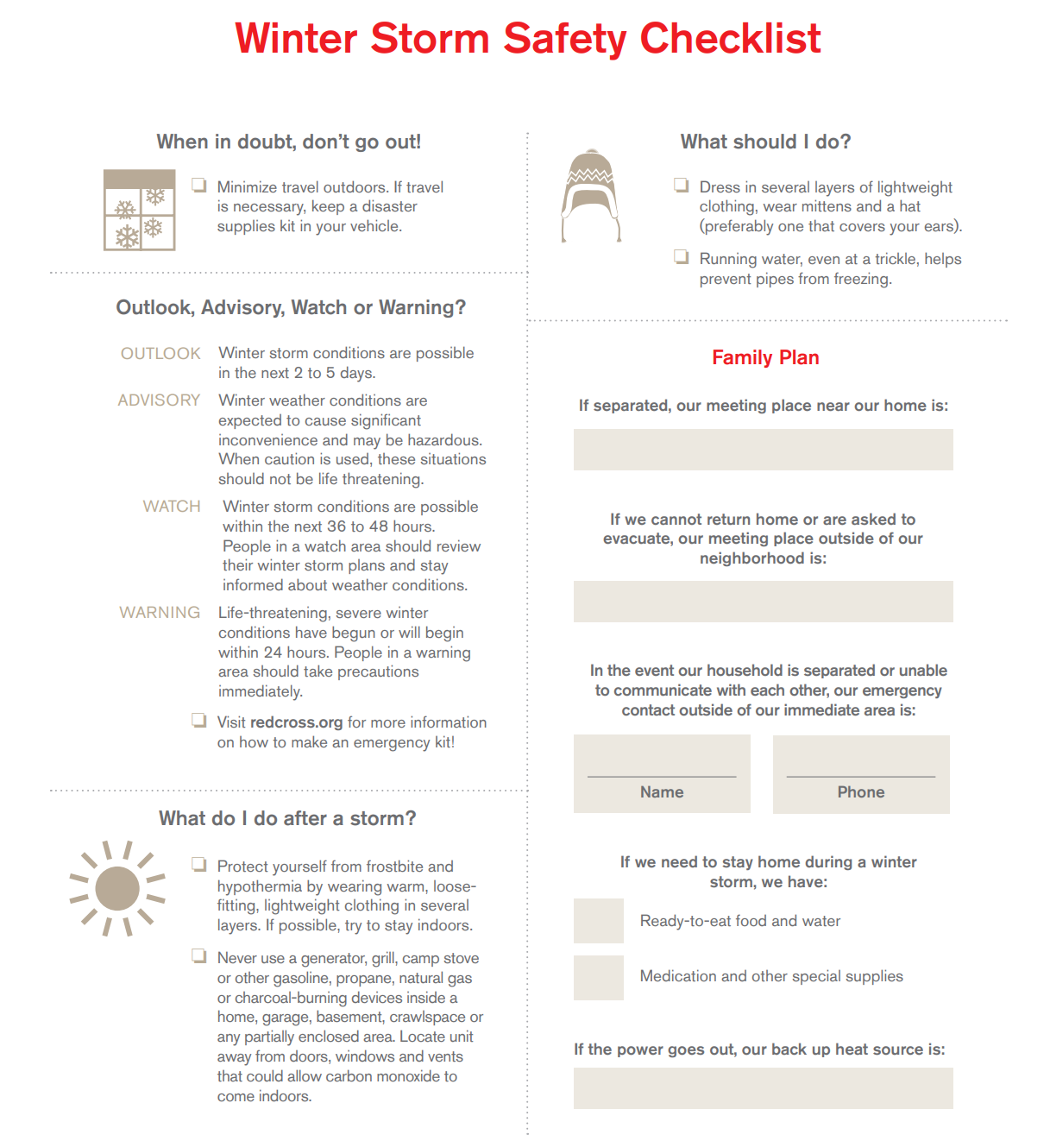

Slide 27

Emotional Health After a Disaster
OPTIONAL: For extended timeframe
Disasters can be stressful.
Know the signs of stress.
Take steps to help manage stress and minimize lasting effects.
Get help when you need it.
V.2 2020.07.14
Notes:
---------------------------------------------------------------
OPTIONAL SLIDE: Use if time permits, <two minutes>.
We have learned today how to prepare for a disaster. We must also recognize the need to be ready for the aftermath of a disaster should one occur.
Disasters can be stressful.
The good news is that there are things we can do to cope with stress.
First, be aware of feelings that can come with disasters.
Speaker Note: Ask participants to identify feelings and reactions to watch for after disasters, then summarize with:
You may:
Feel physically and mentally drained
Have difficulty making decisions or focusing
Become easily frustrated
Find yourself arguing with friends and family
Feel sad, numb, lonely, or worried
Experience changes in appetite or sleep patterns
Speaker Note: Ask participants for things to do that help with stress, then summarize with:
You can help deal with stress by doing the following:
Be sure you and your loved ones are safe.
Eat healthy foods and drink plenty of water.
Get rest.
Stay connected with family and friends.
Be patient with yourself and those around you.
Set priorities and break down tasks into small ones.
Gather information about help and resources.
Stay positive and help others.
If the stress continues or worsens, or if you or someone you know is feeling life isn’t worth living, seek immediate help.
---------------------------------------------------------------
---------------
Source:
www.redcross.org/images/MEDIA_CustomProductCatalog/m4240142_EmotionalHealth.pdf
Preparedness Essentials
OPTIONAL: For extended timeframe

Slide 28
Home Fires
Notes:
Welcome to this Be Red Cross Ready presentation. Thank you for your interest and for joining us today.
My name is …
Speaker Note: If time permits, ask participants to introduce themselves.
Before we get started, let’s briefly go over some safety and logistics information:
Review location’s safety information:
Location of emergency exits
Designated meeting place in the event of a fire
Location of AED
Other safety information (Customizable)
Review logistics, may include:
Location of bathrooms
Schedule for breaks
Smoking areas
Cell phones are only to be used outside of the classroom - please silence them.
Listen respectfully to others.
Any other location-specific information, i.e. parking restrictions, etc.
If you’ve set aside seats for those with low vision or difficulty hearing, advise them to “please take a seat in the front if you like to hear or see the presentation better.”

Slide 29




Home Fire Causes
46%
19%
25%
22%
19%
16%
5%
Fires
Deaths
Fires
Deaths
Fires
Deaths
Notes:
Home Fires
Let’s look at some of the major causes of homes fires and home fire fatalities:
Cooking equipment is the leading cause of home fires and home fire-related injuries, and accounts for 19 percent of home fire fatalities.
Malfunctioning (16 percent) and improper use (19 percent) of heating, electrical, and lighting equipment together account for 35 percent of home fire fatalities.
While only 5 percent of home fires are started by smoking materials, these fires are the leading cause of home fire fatalities.
So how can you reduce the risk of fires in your home? Some home fires can be prevented by following basic safety tips.
---------------
Source:
ARC Home Fires Educator Deck, slide 5

Slide 30
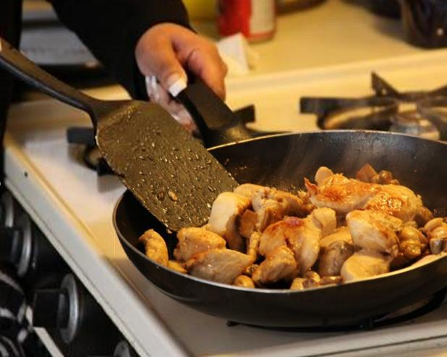
Reduce Fire Risk in Your Home
Stay in the kitchen when cooking.
Never leave anything burning unattended.
Install fire extinguishers.
Keep an eye on what you fry!
Notes:
Unattended cooking is responsible for one-third of reported home cooking fires.
Always stay in the kitchen when something is cooking on the stove. Remember, keep an eye on what you fry!
Install and learn how to use a fire extinguisher. Contact your local fire department for training.
Speaker Note: List continues on next slide.
---------------
Sources:
ARC Home Fires Educator Deck
ARC Home Fire Preparedness - www.redcross.org/get-help/how-to-prepare-for-emergencies/types-of-emergencies/fire/home-fire-preparedness
Home Fires

Slide 31
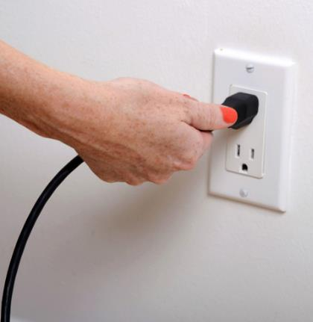
Reduce Fire Risk in Your Home
3 feet from the heat!
Plug appliances directly into wall outlets.
Avoiding overloading outlets.
Make sure electrical cords are used safely.
Notes:
If you recall, 35 percent of home fires are the result of malfunctioning or improperly used heating, electrical, and lighting equipment. You can reduce this risk by remembering these safety tips:
More than half of the deaths resulting from home heating fires are caused by heating equipment that is too close to things that burn. Make sure anything that could catch fire – such as furniture, curtains, dishtowels, or clothing – is at least three feet away from any heat source. Remember, three feet from the heat!
Always plug appliances directly into wall outlets – avoid extension cords. Extension cords are intended for temporary use. If necessary, have a qualified electrician add more outlets in your home to reduce the use of extension cords.
Avoid overloading outlets or extension cords – don’t plug multiple power strips or extension cords with several items attached into the same outlet.
Make sure electrical cords aren’t damaged, running under carpets, attached by nails, or in high traffic areas.
---------------
Sources:
ARC Home Fires Educator Deck
ARC Home Fire Preparedness - www.redcross.org/get-help/how-to-prepare-for-emergencies/types-of-emergencies/fire/home-fire-preparedness
Home Fires

Slide 32

Smoking is Dangerous
Never smoke in bed or when drowsy.
Never smoke where medical oxygen is used.
Always properly extinguish.
Keep matches and lighters away from kids.
Notes:
Failing to properly extinguish smoking materials (including cigarettes, pipes, and cigars) is the leading cause of residential fire deaths in the United States. If you or anyone in your home smokes – including guests – remember to:
Smoke outside.
If you do smoke indoors – never smoke in bed, when drowsy, or if anyone is using an oxygen tank.
Use deep, sturdy ashtrays, and always properly put out the butts – a good douse with water before disposing of them is best.
Keep matches and lighters out of children’s reach, preferably in a locked cabinet or container where they are also out of sight.
If you vape:
Never leave it charging overnight or unattended and always use the charger that it came with.
Replace batteries that are wet or damaged.
---------------
Sources:
ARC Home Fires Educator Deck
ARC Home Fire Preparedness - www.redcross.org/get-help/how-to-prepare-for-emergencies/types-of-emergencies/fire/home-fire-preparedness
Tips to Help Avoid “Vape” Battery Explosions, U.S. Food & Drug Administration - www.fda.gov/TobaccoProducts/Labeling/ProductsIngredientsComponents/ucm539362.htm#blue
Home Fires

Slide 33
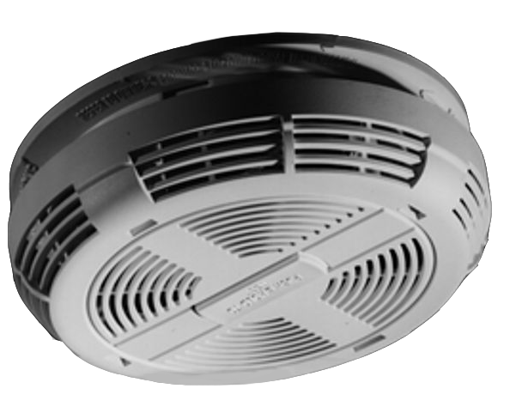
Smoke Alarms Save Lives
Install on every floor – inside and outside of sleeping areas.
Test every month.
Maintain them properly.
Replace after 10 years.
Don’t disable alarms!
Notes:
Now that we’ve talked about safety tips for reducing the risk of home fires, I want to remind you about the importance of working smoke alarms.
Did you know that research conducted by the National Fire Protection Association shows that three out of every five home fire deaths happen in homes with either no smoke alarms or nonworking smoke alarms? Not only that, but having a working smoke alarm cuts the risk of dying in a home fire by half.
There are some very important things to remember when it comes to smoke alarms.
Install smoke alarms on every level of your home, inside bedrooms, and outside sleeping areas. It is also highly recommended that they be interconnected – this way, when one alarm sounds, they all sound.
Test each alarm monthly using its test button.
Replace the batteries at least once a year for those alarms requiring battery replacement.
Replace the smoke alarm itself every 10 years (all smoke alarms – this includes hard-wired units).
And I know it can be tempting to disconnect a smoke alarm after it has sounded because something you are cooking creates too much smoke, but NEVER disable a smoke alarm, even temporarily. Use the silence (or hush) feature if you are getting a nuisance alarm. If you experience frequent false or nuisance alarms, consider relocating the unit to another location.
Older individuals and those who are deaf or hard of hearing are particularly at risk during a home fire because they may not be able to hear the sound of a standard auditory smoke alarm. Devices are available to overcome these challenges. They can use a low-pitched sound, vibrations under your pillow or mattress, or strobe lights.
Additional resources for individuals with access or functional needs may be available through your community’s Center for Independent Living. To find a local Center for Independent Living, use the link (www.ilru.org/projects/cil-net/cil-center-and-association-directory) and select the state that you reside in.
---------------
Sources:
ARC Home Fires Educator Deck
www.nfpa.org/Public-Education/By-topic/People-at-risk/People-with-disabilities/Educational-materials/People-who-are-deaf-or-hard-of-hearing
Centers for independent Living - www.ilru.org/projects/cil-net/cil-center-and-association-directory
Home Fires

Slide 34
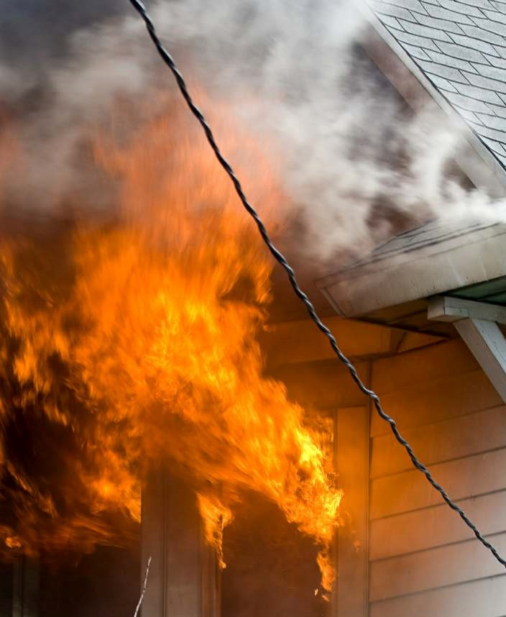

Know What to Do
Find a safe escape route.
If there is smoke, get low.
Meet at the designated safe meeting place.
Call 911 once safe.
Get out and stay out!
Less than 2 minutes
Notes:
Everyone in your household needs to know what to do when a smoke alarm sounds. If a fire starts in your home, you may have less than two minutes to escape quickly.
Get out and stay out! Leave everything behind, get out as quickly as you can, and NEVER go back into a burning building.
If smoke or fire blocks one of your ways out, use another way out.
If you must go through smoke, get low and go under the smoke to escape.
Everyone in your household should plan to meet at the designated Safe Meeting Place.
Call 911 from a safe place outside your home.
---------------
Sources:
ARC Home Fires Educator Deck
ARC What To Do if a Fire Starts - www.redcross.org/get-help/how-to-prepare-for-emergencies/types-of-emergencies/fire/if-a-fire-starts
ARC Home Fire Preparedness - www.redcross.org/get-help/how-to-prepare-for-emergencies/types-of-emergencies/fire/home-fire-preparedness
Home Fires

Slide 35
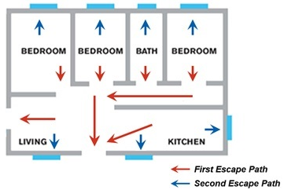
Plan Escape Routes
Two exits from every room
Windows and doors open easily
Escape ladders for second floors and above
Escape routes clutter free
Notes:
So, we should talk more about how to plan your escape route.
Each room should have two exits, such as a door and a window.
Make sure that windows and doors open easily to allow for quick escape.
If your home has security bars, make sure the bars have emergency release devices inside so that they can be opened immediately in the event of an emergency.
Consider escape ladders for second-floor sleeping areas or homes on the second floor or above.
It’s also important to keep escape routes free of clutter and tripping hazards.
As the diagram shows, each room has two ways out. The first escape path out of each room is through the door and then out of the house. The second escape plan is through the nearest window in each room.
---------------------------------------------------------------
OPTIONAL ACTIVITY: If time permits <five minutes>, provide participants with a blank escape plan and instruct them to identify two routes out of each room. It can be found here:
www.redcross.org/images/MEDIA_CustomProductCatalog/m38640160_Home_Fire_Escape_Plan.pdf
---------------------------------------------------------------
---------------
Sources:
ARC Home Fires Educator Deck
ARC A Home Fire Escape Plan Can Save Your Life - www.redcross.org/news/article/A-Home-Fire-Escape-Plan-Can-Save-Your-Life
ARC Is Your Home a Fire Hazard? - www.redcross.org/get-help/how-to-prepare-for-emergencies/types-of-emergencies/fire/is-your-home-a-fire-hazard
ARC Home Fire Preparedness - www.redcross.org/get-help/how-to-prepare-for-emergencies/types-of-emergencies/fire/home-fire-preparedness
Home Fires

Slide 36
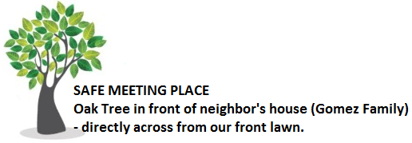
Safe Meeting Place
Safe distance away
Specific, fixed location
In front of home
Call 911 once safe
Notes:
Knowing how to quickly get out of your home is only one part of the escape plan. A home fire is very confusing and may require members to use different escape routes. This is why you need one specific Safe Meeting Place where everyone will meet in the event of a home fire.
Identify a location that is a safe distance from your home – in a specific and fixed location.
Make sure it is in the front of your home so that you can easily meet firefighters and let them know that everyone is safe and accounted for.
Remember – always call 911 from a safe place, outside your home.
Speaker Note: Use the optional activity only if you included it with slide 30.
---------------------------------------------------------------
OPTIONAL ACTIVITY: If time permits <two minutes>, ask participants to label a safe meeting place on their escape plan. It can be found here:
www.redcross.org/images/MEDIA_CustomProductCatalog/m38640160_Home_Fire_Escape_Plan.pdf
---------------------------------------------------------------
---------------
Sources:
ARC Home Fires Educator Deck
ARC Home Fire Preparedness - www.redcross.org/get-help/how-to-prepare-for-emergencies/types-of-emergencies/fire/home-fire-preparedness
Home Fires

Slide 37
Works for Everyone
Assign evacuation assistants.
Assess functional abilities and needs.
Practice with pets.
Arrangements:
2-year-old son requires assistance to evacuate
  Mom — Primary person
  Dad — Secondary person if mom away
http://www.ilru.org/projects/cil-net/cil-center-and-association-directory
Notes:
It is vital that your escape plan works for everyone in the household. Make arrangements for infants, children, older adults, and individuals with access or functional needs who may need assistance to escape during a home fire.
Make sure that someone in the household is assigned to each person who may require assistance – and be sure to identify a backup person, in case the primary person is not home during the fire.
In the example on the slide, the family has a 2-year-old son who will need help to evacuate. Mom is the primary person and dad will help if mom is away.
Remember, smoke alarms may not always wake up children in the event of a home fire.
Speaker Note: Write the website address (www.ilru.org/projects/cil-net/cil-center-and-association-directory) on a flipchart or whiteboard.
---------------
Sources:
ARC Home Fires Educator Deck
ARC Home Fire Preparedness - www.redcross.org/get-help/how-to-prepare-for-emergencies/types-of-emergencies/fire/home-fire-preparedness
ARC Pet Fire Safety - www.redcross.org/get-help/how-to-prepare-for-emergencies/types-of-emergencies/fire/pet-fire-safety
Home Fires

Slide 38
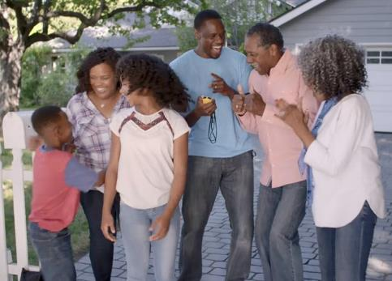
Practice Home Fire Escape Plan
Practice your home fire escape plan at least twice a year.
Script requires PERSONALIIZATION
Notes:
Once the plan is complete, written down, and shared with all household members, it should be practiced at least twice a year.
If you have someone with access or functional needs, you should have a personal support network to assist during an emergency. Be sure you include them in your practice drills.
Practicing makes sure the plan will actually work for everyone and as expected. If not, you can make the necessary adjustments and practice again.
Speaker Note: If time permits <two minutes total>, provide a real-life example of how your household practices fire escape plans.
​
---------------
Source:
ARC What To DO if a Fire Starts - www.redcross.org/get-help/how-to-prepare-for-emergencies/types-of-emergencies/fire/if-a-fire-starts​
Home Fires
Script requires PERSONALIIZATION

Slide 39

Be Prepared and Take Action
      Make a home fire escape plan.
      Test your smoke alarms every month.
      Practice your home fire escape plan.
Notes:
You’ve gotten a lot of information today, so lets review how you can keep the members of your household safe with a few easy steps.
Step 1: Make a home fire escape plan.
Step 2: Test your smoke alarms monthly.
Step 3: Be sure to practice your home fire escape plan at least twice a year with your entire household.
Speaker Note: If available, pass out the Home Fire Safety Checklist <two minutes>. It can be found here:
www.redcross.org/images/MEDIA_CustomProductCatalog/m38640159_Home_Fire_Safety_Checklist.pdf
---------------
Source:
ARC Home Fires Educator Deck
Home Fires

Slide 40
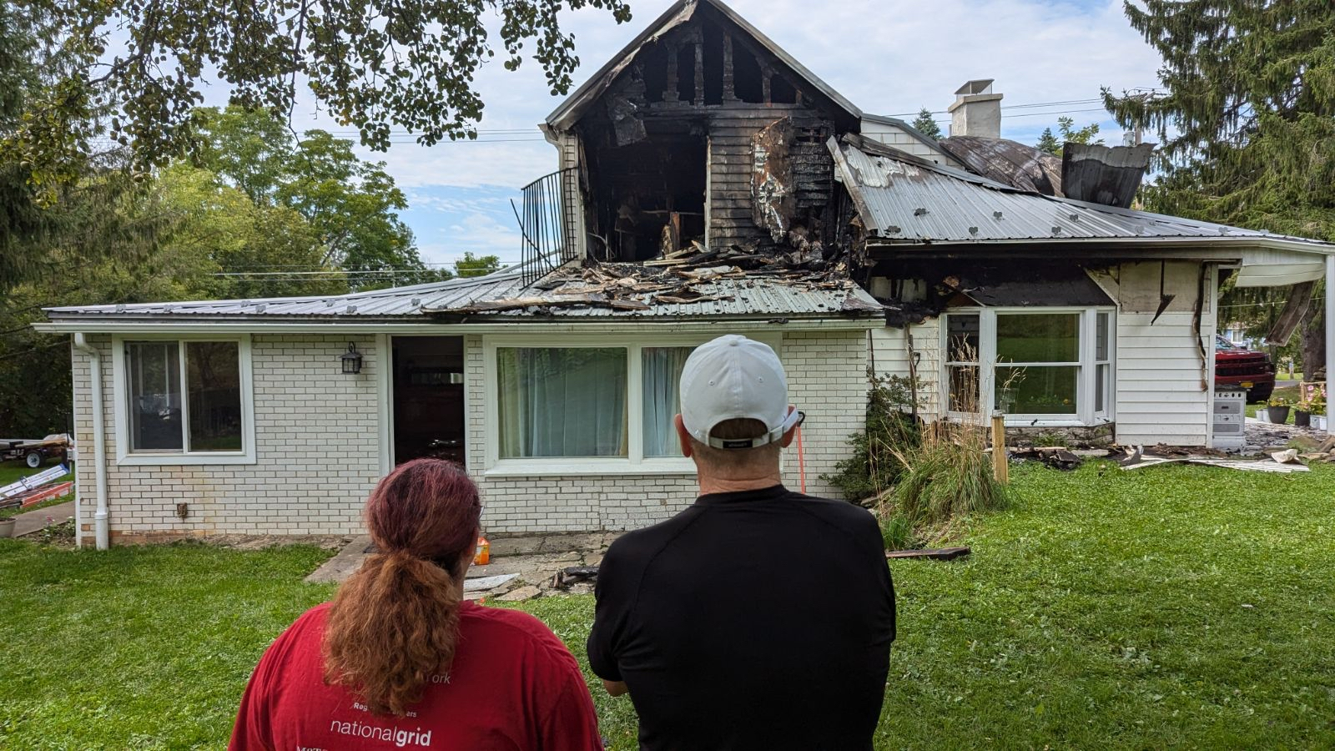
Red Cross Responds to Home Fires in Western New York Everyday
Notes:
Red Cross responded to 146 home fires in the City of Buffalo in 2023
Last week Julianna and I responded to a home fire on the Westside. Two adults lived in an upstairs apartment. One heard the smoke alarm go off at the same time as seeing some gray smoke. He told us, within seconds the smoke turned dark black and got hot. It was hard to move around. He woke up his mother who was in the other room and they rushed outside. They had some minor injuries from rushing down the stairs but they were both okay. Sadly they lost their pets in the fire. Their apartment was destroyed and they lost all of their belongings. Renter's insurance.

Slide 41
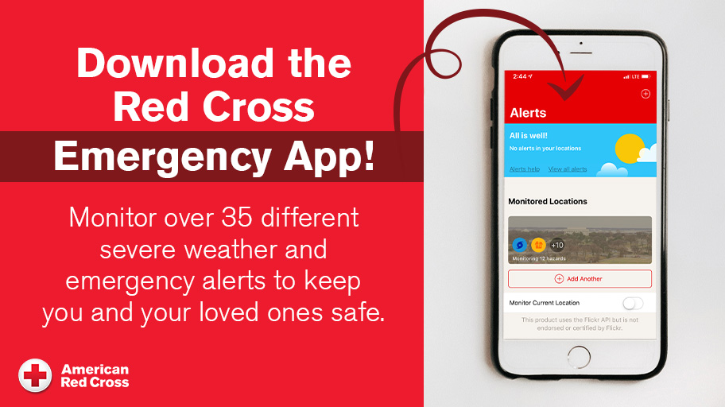
Notes:
The American Red Cross Emergency App gives people instant access to customizable weather alerts, safety tips and preparedness information for 14 different emergencies, all in one free and easy to use app.
• Family members and friends across the country can help each other stay safe and connected through the app’s customizable emergency alerts and content on what to do before, during and after disasters - regardless of where they live.
• The app provides expert advice on what to do in case of a tornado, hurricane, earthquake, flood, thunderstorm, wildfire, winter storm and other disasters.
• People can use the “Make a Plan” feature to create an emergency plan for their household so everyone knows what to do and where to go if a disaster strikes.
• The Emergency App is available for free in app stores for smartphones, tablets and wearables and can also be found by searching for American Red Cross or by going to redcross.org/apps.

Slide 42
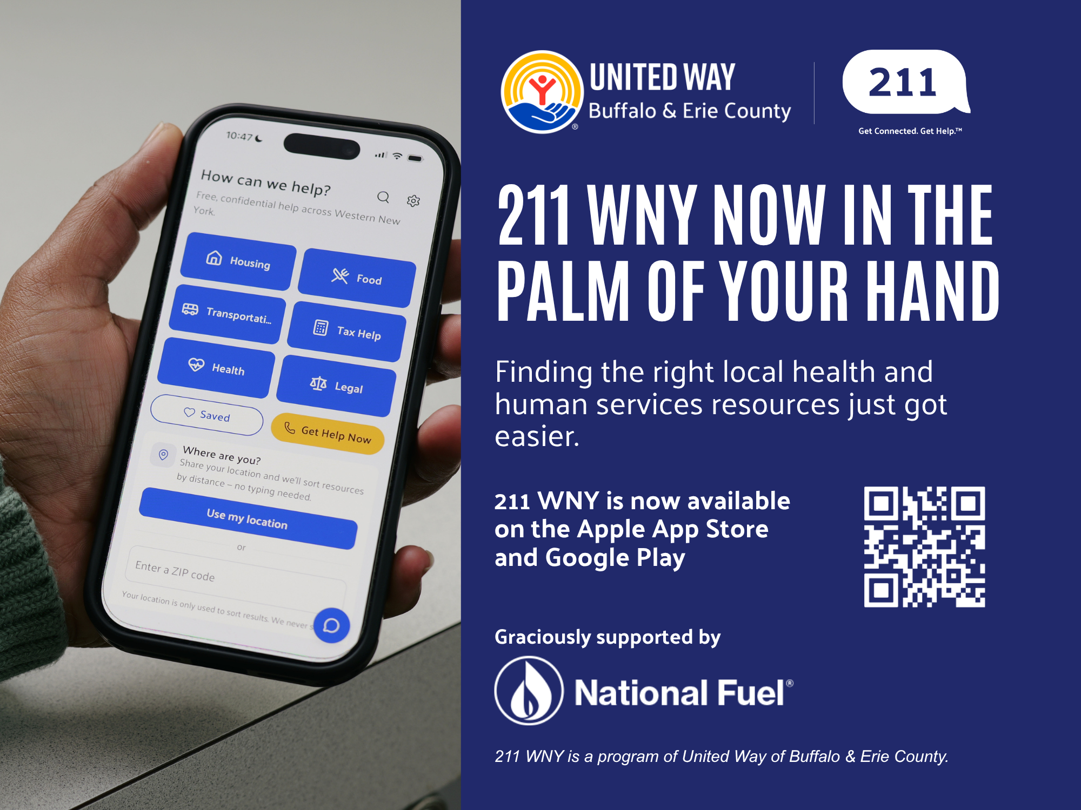
12

